Slide 1
PubSubHubbub
Wikidata.lib
Sebastian Brückner, Alexander Lehmann
13.03.2014

Slide 2
Agenda
Implementation
Tests
Composer
Customer Reports
DBPedia
Google Knowledge Graph
Protocol issues
Deployment

Slide 3
PubSubHubbub
PubSubHubbub (PuSH) is a protocol that enables resources to push changes to subscribers.
Notes:
Warum push?: Pushing > Polling
Warum PubSubHubbub?: Idee von WikiData

Slide 4
Implementation

Slide 5
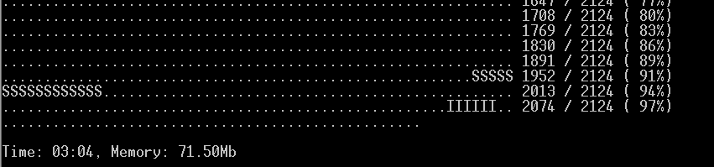

Tests
Why do we test?
works as expected
do not destroy other parts of the software
meets design requirements

Slide 6
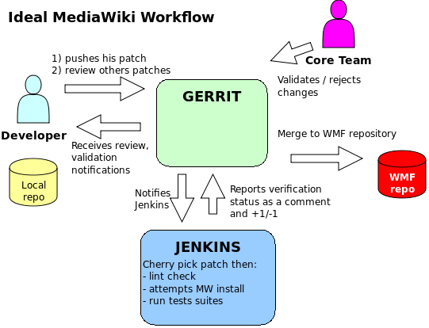
Mediawiki Workflow
http://upload.wikimedia.org/wikipedia/mediawiki/0/0e/GitWorkflow.svg

Slide 7

PHPUnit
﻿testing framework for PHP
﻿instance of the xUnit architecture
Conventions:
The tests for a class “Class” go into a class “ClassTest”
ClassTest inherits from PHPUnit_Framework_TestCase
Each test methods has an assertion methods

Slide 8
What do we test?
onPageContentSaveComplete creation of the publishing job
Database mockup
/**
* @group Database
*/
class PubSubHubbubTest extends MediaWikiLangTestCase {
..
}
Create a test article with a base revision
$title = Title::newFromText( "text" );
$article = new Article( $title );
$baseRevId = false;

Slide 9
What do we test?
Check job table
$row = [ [ 0 ] ];
$this->assertSelect( "job", "count(*)", "", $row );
Generation of the link headers
static string comparison
(publishing of changes)

Slide 10
Composer

Slide 11

Customer Reports - DBpedia
Use currently ﻿OAI-PMH
Requirements
Mirroring of all entities
Metadata of changes
Subscriber client
As many output formats as possible
Wiki Markup unnecessary

Slide 12
Protocol issues
original for RSS-Feeds → resource = URL
URL for all changes
New URL for all output formats
No metadata
Insert, deletes, changes indistinguishable
Wikipage URL ≠ resource URL
Groups of resources not supported
Performans issues

Slide 13
Possible Solution
Publisher is connected with the export interface of Mediawiki
Subscriber is connected with the import interface of Mediawiki
Only publish changes of all resources and changes of a single resource
Groups support can be implemented by subscribers

Slide 14
Deployment

